Slide 1


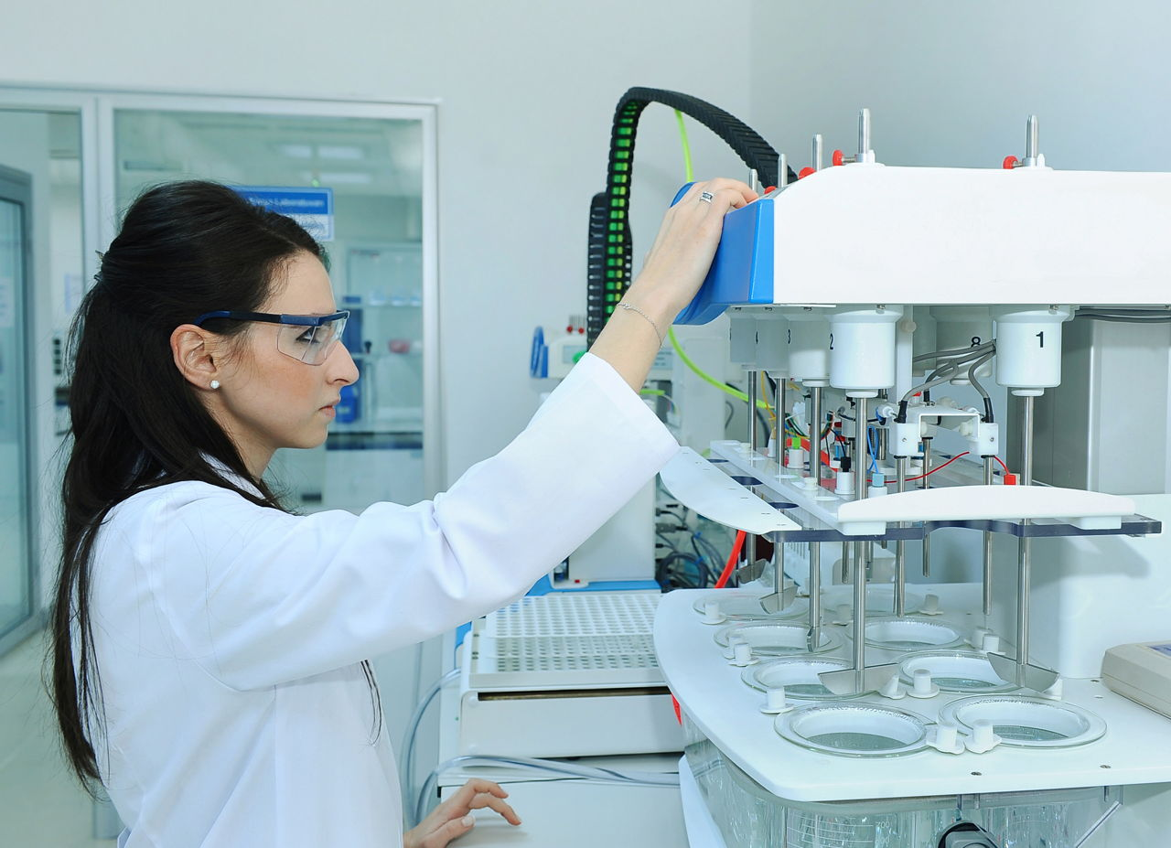

PHARMACEUTICAL INDUSTRY PROFESSIONAL DIPLOMA (PIPD)
www.just.edu.jo/PIPD

Slide 2







Program Qualifications
Pharmaceutical Industry Professional Diploma (PIPD) a GMP Diploma
The post graduate GMP Diploma is a diverse Quality Management System program that gives enrolled students a comprehensive introduction to the various skills in different areas related to Pharmaceutical Industry and GMP compliance required in this industry, and throughout its supply chain. This program, accommodated by Jordan University of Science and Technology in Jordan. includes research and development, regulatory, procurement and storage of the raw materials, manufacturing, testing, release, storage and supply of finished products. It focuses on the compliance requirements in all these areas in terms of qualification, validation and documentation. The program will also introduce the students to the requirements of the facility, utilities and equipment design to remain within the compliance status.
This program entails a strong industry focus, both in terms of teaching and learning objectives and also in terms of program delivery. Teaching is designed and will be conducted by industry-based professionals to ensure practical experiences are presented to equip students to take up important positions in pharmaceutical industry.
The program has also an optional project-
component, where students will have the
opportunity to undertake project from the
industry, within laboratories and
manufacturing facilities located in
Jordan. The project component subject
depends on student interest and
availability of training site. Special fee
will be charged for this component.
Pharmaceutical Industry Professional Diploma (PIPD) is made of 9 modules.
Typical Admission requirements:
Successful completion of an appropriate undergraduate in science, pharmaceutical, or engineering degree program, or the equivalent. (An advanced diploma with appropriate work experience is one typical example of a degree equivalence.)
Students who have not completed a degree or advanced diploma may be admitted to the graduate certificate on a case-by-case basis dependent on their work experience including level of responsibility and duration. Three years’ experience in a relevant field would normally be the minimum.
English language proficiency consistent with the policies for admission to post-graduate programs will be required for entry to the program.
Duration of the program
PIPD diploma can be completed in two semesters, 9 months.

Slide 3







Module No.
Subject
Total number of hours/ modules *
Pre- requisites
Some subjects in the program will have other subjects as pre-requisites.
Module 1
Regulators to cGMP in pharmaceuticals Manufacturing:
FDA
Europe
WHO
PICS
ICH
19
Assessments is done for each module and subject individually, with end of module exam and assignments.
Assessments
Module 2
Drug product development:
Pre-formulation
Formulation
Analytical methods development, validation and transfer
Stability studies
Shelf-life evaluation
CTD 3 preparation
Setting Specification for raw material, intermediate product and finished drug product
Bio-batch and scale up activities
API sourcing and Supplier qualification: DMF evaluation
33
Typically, as follows:
Lectures/Tutorials, Case studies based on actual events that have occurred in the pharmaceutical and related industries will be used.
Teaching Methods
Facilities required
The program will require an E-learning base at the university. The program will be taught online in flexible manner to suit participants.
Module 3
Quality Control:
Good laboratory practices
Raw material testing
Finished product testing
Stability studies
OOS and OOT
Reference standards
Retained samples
Microbiology testing
Testing Instruments qualifications and calibration
Weighing and balances
Purified water testing
QC testing reporting
IPC testing
Sampling
Materials and products testing and release
47
Notes, textbooks and references will be assigned for the 9 modules/subjects to be delivered during the course. Students are expected to access and read the materials assigned for the subjects to be taught.
Textbooks and Notes
Certificate will be issued upon successful completion of the program from Jordan University of Science and Technology, Irbid, Jordan. The certificate is accredited by The Ministry of Higher Education. This Diploma is not intended to obtain academic degree and the training hours will not be accredited as credit hours for other academic programs.
Disclaimer

Slide 4





Module No.
Total number of hours/ modules*
Module No.
Subject
Total number of hours/ modules*
3636
Subject
Module 4
Quality Assurance System:
Quality management system
Internal audits
Corrective /Preventive actions
Deviation handling
Product Quality Review
Management review
Quality risk management
Change control and post approval changes
Batch record review and batch release
Complaints
Product recall
Documentation and document control
External inspections
Technical agreements
Validation Master Plan
47
Module 7
Personnel and training requirements:
Personnel qualification and training
Qualified person
Personnel hygiene monitoring
Personnel health check
17
Module 8
Regulatory:
CTD (Common Technical Document) and eCTD
Regulatory requirements for products registration in different countries
Pharmacovigilance
Patents and patents regulation laws
38
Module 5
Engineering:
Facility, equipment and utilities requirements
Site master file
Equipment and premises: Design, material and personal flow layouts
HVAC system
Water treatment system
Utilities for pharma
Corrective maintenance
Preventive maintenance
Utilities and equipment Calibration
Documentation
Equipment qualification
Utilities qualification
MBS
Computer system validation and verification
43
Module 9
Pharmaceutical’s storage and distribution requirements:
Stores’ design and materials/ products flow
Materials receipt, quarantine, release and storage
Products quarantine, release and storage
Good storage and distribution practices
ERP systems
Products distribution
Pest and rodents’ control
Environmental monitoring and control
Thermal mapping and qualification of the stores and the distribution vehicles
Reject handling and disposal
45
Module 6
Production Operations and Process Control:
Manufacturing
Packaging
Batch record
Gowning, Sanitization and hygiene
Documentation
Process charts control and production in process testing
Contract manufacturing and packaging
Environmental monitoring and control
Process validation
Cleaning Validation
33
* Student contact hours include online lecturing, assignments, tests and exams, case studies and face-to-face interactions.

Slide 5

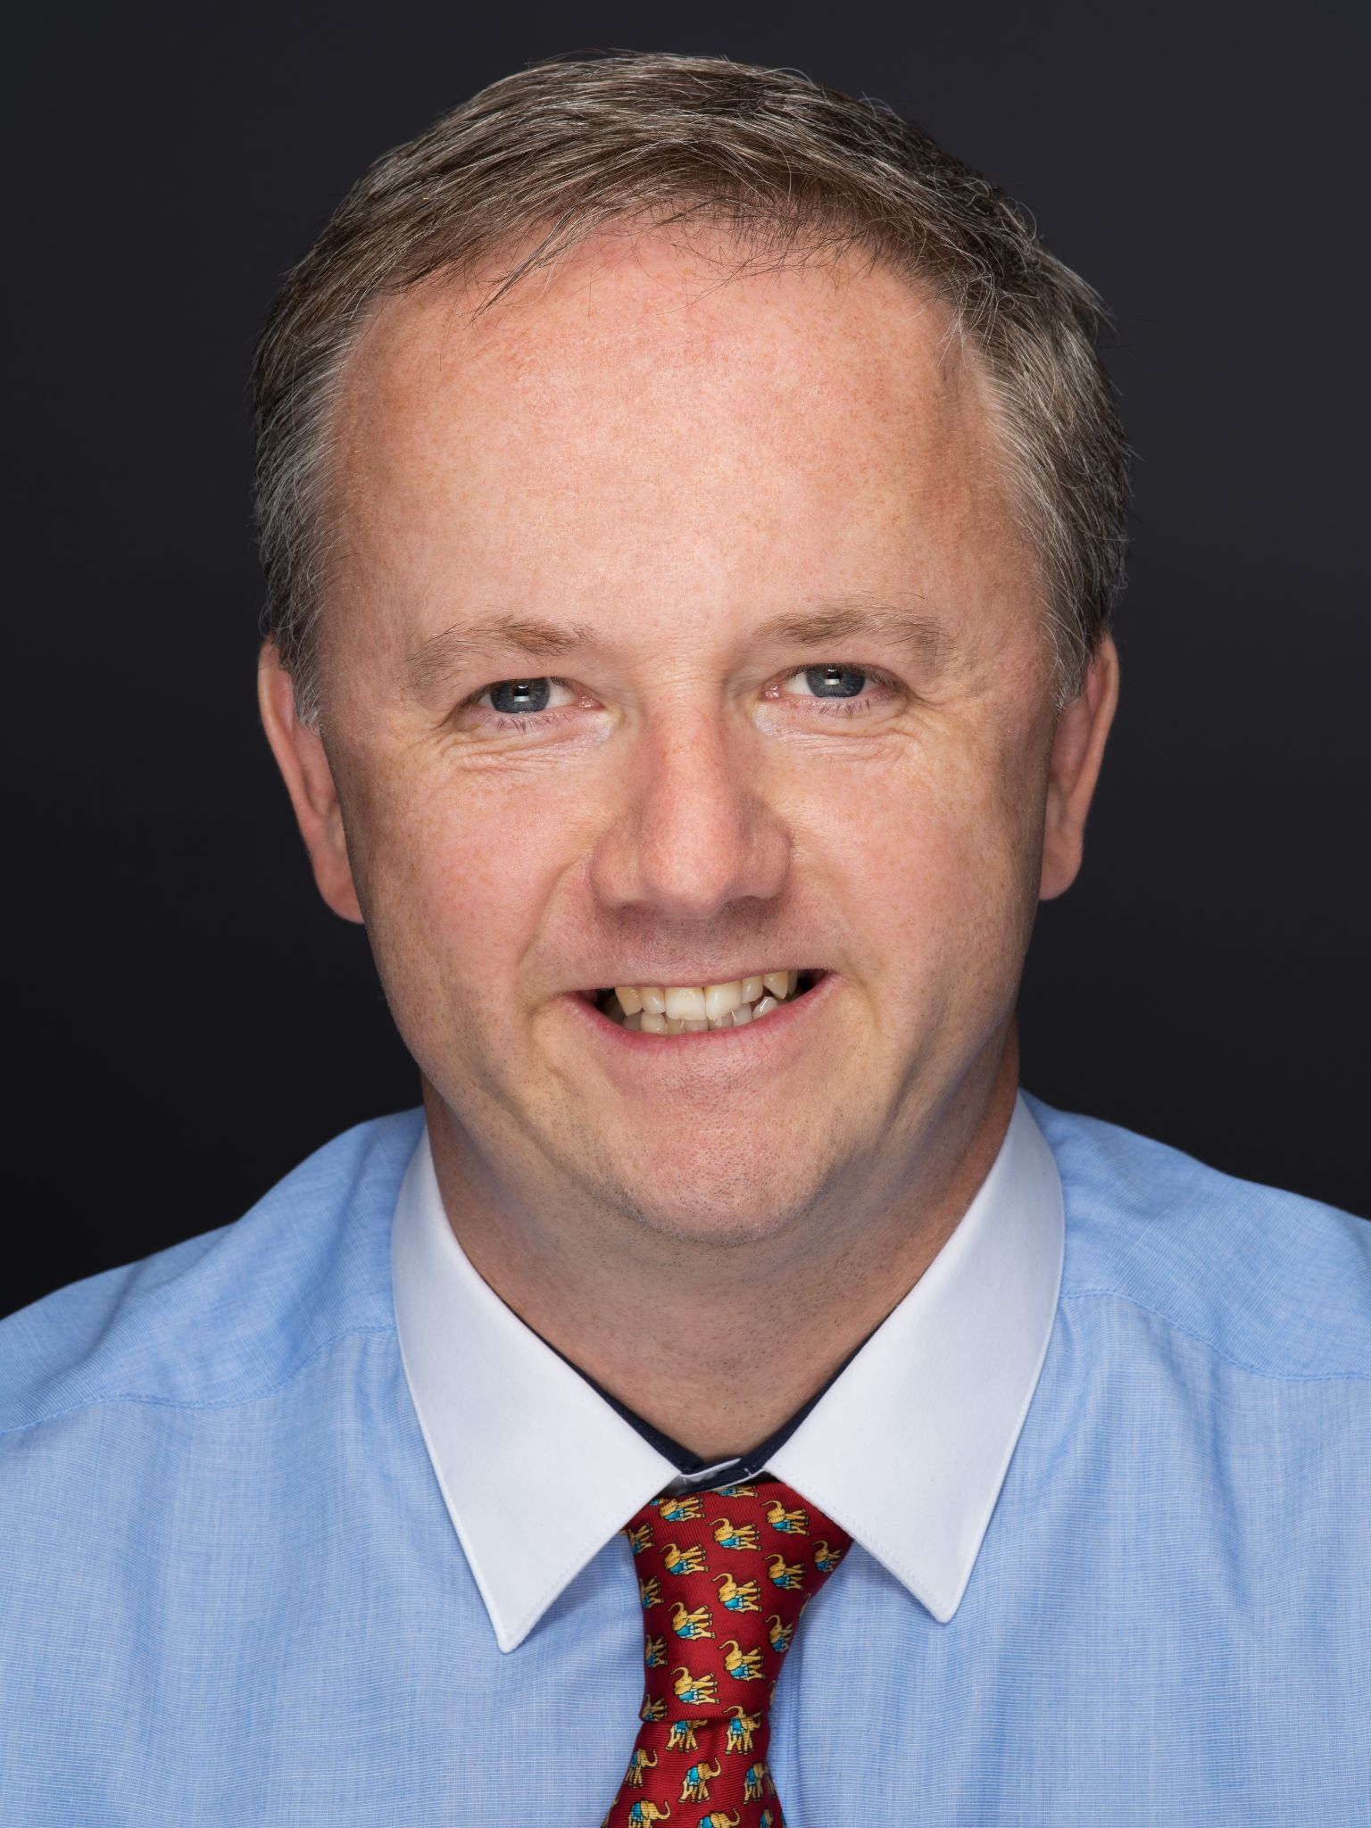


Lecturers/speakers biography
Dr Bashar M Altaani, PHD
- Holds a PhD degree in Industrial and
Physical Pharmacy from Purdue
University in the USA
- Currently, He is an Associate Professor in Department of Pharmaceutical Technology in Jordan University of Science and Technology.
- He teaches pharmaceutical manufacturing and pharmaceutical quality assurance courses in the school of pharmacy.
- He has held several workshops for topics related to pharmaceutical manufacturing and performed several projects with Pharmaceutical industry.
Dr Nadia ARA Ghazal, PhD
- Holds a PhD degree in Pharmaceutical
Technology and master degree in
Biotechnology from Bath University UK.
- Gathered over 30 years of experience in pharmaceuticals manufacturing, storage and distribution according to FDA, EU, WHO, HC, MHRA cGMP/GSDP regulations and guidelines.
- She has gained a track record for dynamic involvement in launching systems in GMP compliance and pharmaceuticals development, manufacturing,
storage and distribution. She Secured significant
approvals related to pharmaceutical industry
benchmarks.
Mr. Paul R Palmer
- Holds an MSc degree in Quality Management
and an MBA degree in business administration.
- He has over 35 years experience in the Pharmaceutical Industry.
- He has been an auditor since 1998 and Qualified Person since 2004 and independent Pharmaceutical consultant since 2011.
- Paul is a tutor at RSSL (Reading UK) and University College London providing specialist training in manufacture supply of Pharmaceutical products to trainee & experienced QP’s & RP’s.
Dr. ALUN HOWELLS, PhD
- Holds a PhD degree in synthetic organic
chemistry, specializing in peptide chemistry.
- Currently he is a QA Manager and Responsible
Person for BBUK Ltd.
- He has worked as a professional chemist in the pharmaceutical industry for more than 20 years.
- He has traveled extensively living in four different continents and visiting more than 60 countries around the world.
- His passion is to learn new things and believes that traveling enhances personal growth,
development and experience.

Slide 6



Lecturers/speakers biography
Mr. Tobias Kuners of Koenders
Holds a BSc in Chemical Technology
from HvA Amsterdam (the Netherlands),
a MSc (Corp.) in Manufacturing Management from Cranfield University (UK) and is Certified Supply Chain Professional from APICS (USA).
- Operations Support Specialist and Business Leader with more than 30 years of experience across multiple facets of operations including Project Management, Facilities Services, Maintenance, Engineering, Validation, Packaging and Supply Chain in Cell and Gene, Biotech, (Radio-)Pharmaceutical, Medical Devices, and Food for Special Medical Purposes.
- Coach and mentor, to employees, to team leaders, but mostly to (senior) management. Provides training in systems, processes, techniques, compliance, and qualification. Creates focus and drive assessments and decision-making in short-term and long-term planning and in smaller and larger projects within the organizations.
Mr. Alex Rollins
- Holds a BSc in Business Management
with HR major from Edinburgh Napier University in
Scotland (with distinction), and an MBA from
Northampton university in UK (with Merits).
- Worked for over 5 years as HR specialist in
projects managing pharmaceutical
compliance and manufacturing .
Mr. David Cunha
Studied Chemical Engineering and
Biochemistry in France.
- Has 23 years experience in the Pharmaceutical Industry in a multicultural environment, dealing with organizations across the world either with Pharmaceutical Companies, or their contract manufacturers.
- Held several positions in Manufacturing and Quality, mainly in management of organizations. David has a broad knowledge in the field of GxP from API manufacturing to Finished goods, Medical devices and outsourced activities.
- David worked for major Pharmaceutical companies: Eli Lilly, Novartis, Roche, Bayer and is also busy with consultancy activities and lecturing at University.
- Owner of his company “D2C Life Science”, in order to support Pharmaceutical companies in the way they manage Quality and Compliance activities from a Cost, Risk, and Performance perspective.

Slide 7


Lecturers/speakers biography
Dr. Nida Bawaresh, PhR
- Holds a BSc. degree in pharmacy, and
worked as head of JFDA Pharmacovigilance
and Rationale Drug Use .
- Currently she is working as pharmacovigilance consultant in different fields in pharmacovigilance such as preparation and evaluation of periodic safety updates report (PSUR) and risk management plan (RMP), preparation of pharmacovigilance system master file for industry and pharmacovigilance training.
- Work as lead auditor for pharmacovigilance inspection.
- She has held several workshops and lectures on pharmacovigilance to pharmaceutical manufacturing, drug agents, healthcare providers.
Dr. Hiba Zarour, PhD
- She holds a BSc. degree in Pharmacy, and
LLM degree in Intellectual Property and a Juris
Doctor degree from Pierce Law.
- She is a VP Intellectual Property at Hikma Pharmaceuticals Global Division.
- She is a member of the trade committee of the International Generic and Biosimilar Pharmaceutical Association (IGBA) and the IP committee at the
Jordanian Association of Pharmaceutical
Manufacturers and the Saudi National
Committee of Pharmaceutical Industries.
- She was a speaker on intellectual property for
various national and international
organizations like WIPO and CPhI Russia.
www.just.edu.jo/PIPD

Slide 8

Fees
An introductory competitive fee has been set for this nine months program as follow:
Jordanian 2,999 JD
International $5,699 USD
Registration
The start time for the first cycle of the program will be on September 18, 2021.
A- To register in the program and pay the fees by debit or credit card please visit the following web site. Service fee will be applied.
https://services.just.edu.jo/PIPD
B- To register and pay the fees by bank or wire transfer
For Jordanian to pay by Jordanian Dinar (JD) :
Swift Code
CAABJOAMXXX
Cairo Amman Bank
Amman Jo
Account number 0090003424838
Name: Jordan University of Science and Technology
Branch code: 1300
IBAN number: JO54CAAB130000000003424838
For International to pay by United States Dollar ($USD):
Swift Code
CAABJOAMXXX
Cairo Amman Bank
Amman Jo
Account Number 090003424846
Name: Jordan University of Science and Technology
Branch code: 1300
IBAN number: JO69CAAB130000000003424846
After completion of the transfer process please
visit the following website to provide your
information and submit a copy of the transfer slip
www.just.edu.jo/PIPD
Bank Facilities
Customers holding credit cards issued by Cairo Amman
Bank or eligible customer can pay the fee on monthly installments for 6 months with no interest. Call Cairo Amman Bank call center after paying.
For more information, Please visit
www.just.edu.jo/PIPD
Contact
Pharmaceutical Research Center
Jordan University of Science and Technology
Irbid 22110 Jordan
Telephone: 00962 2 7200600 EXTENSION 40509
Fax: 00962 2 7200643
Email: prc@just.edu.jo
Diploma Email: PIPD@just.edu.jo
Diploma Coordinator: Dr. Bashar M Altaani,
Mobile: 00962 795562651
Diploma registration coordinator: Mr. Alex Odai Hisham Mobile: 00962799150279

